Slide 1
Final Thesis Chapter: Measuring changes in the urban environment using imagery and association w/ demographics changes
Research plan for the next 2-3 months

Slide 2
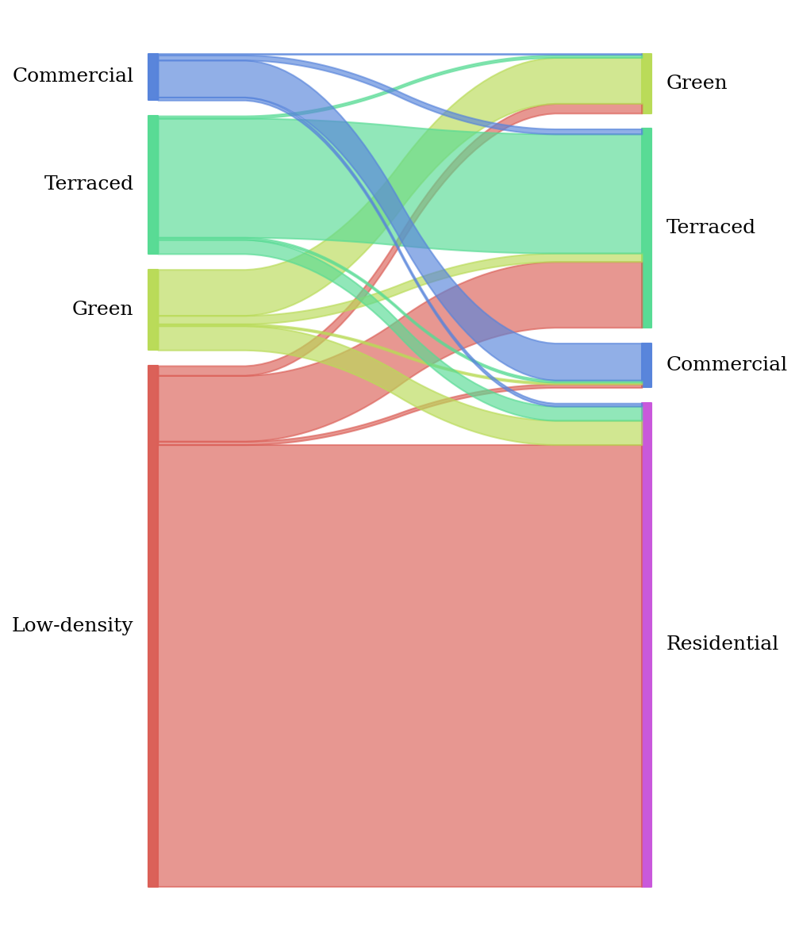
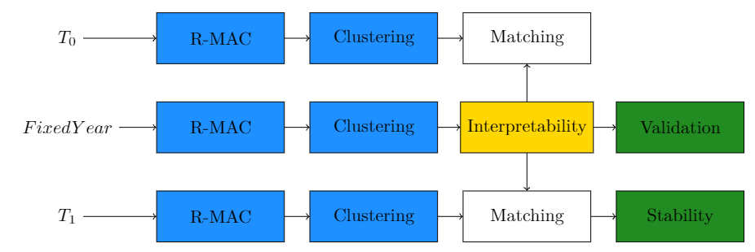
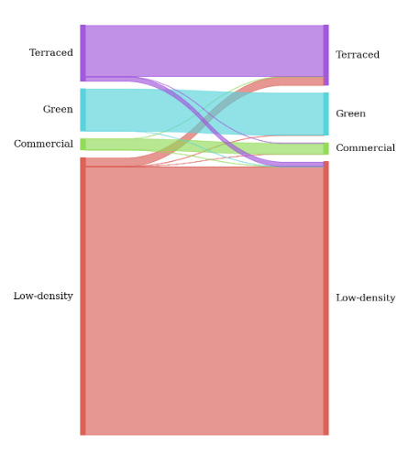
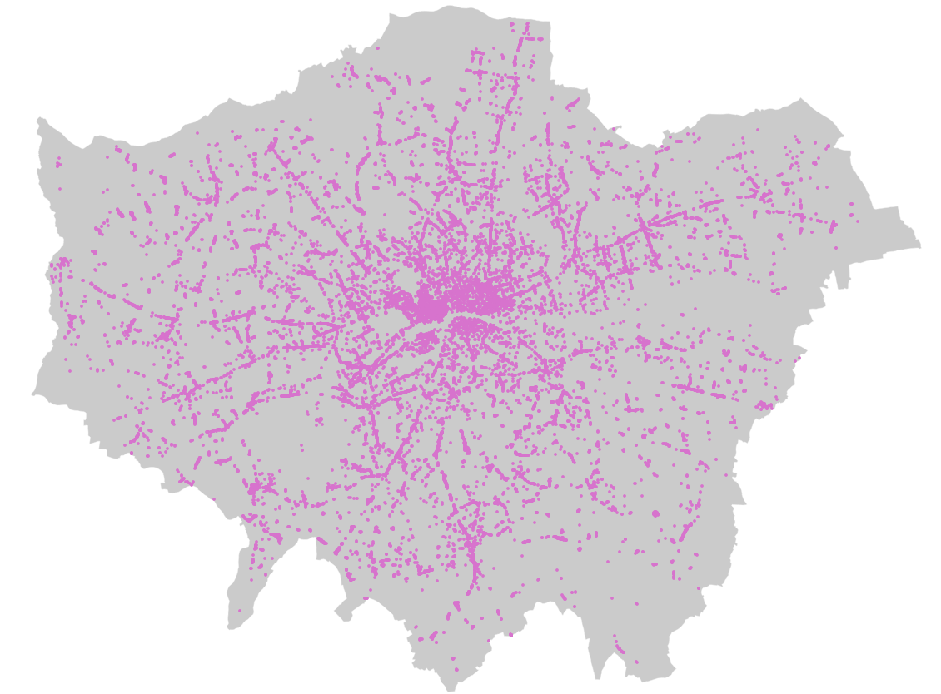
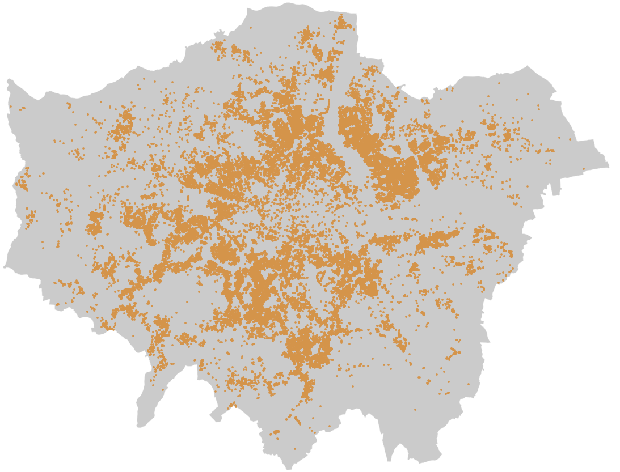
1. Unsupervised Clustering

Slide 3
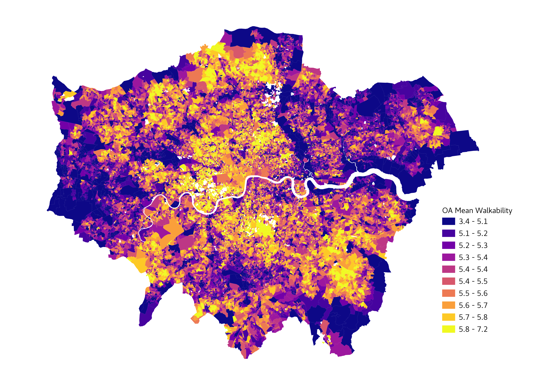
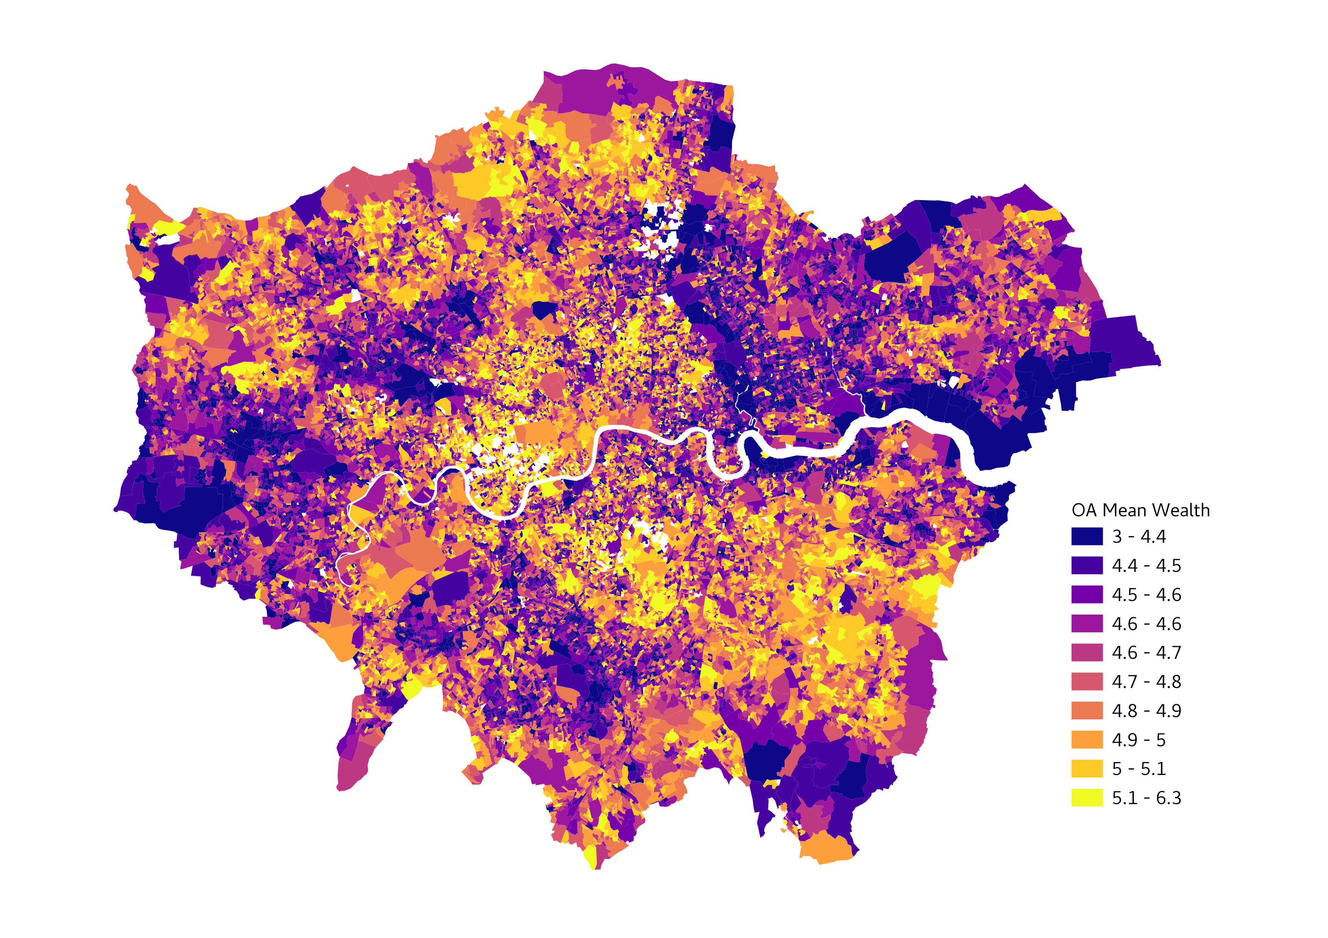
2. Perceptions

Slide 4
3. Temporal Analysis
y
x
2011 OA | 4 Cluster %’s | 6 Perception Scores
1 |  | Running
2 |  | Running
3 |  | Running
4 |  | Running
2011 OA | Census | CRDC | House Prices
1 | Available | Access Granted
2 | Available | Access Granted
3 | Available | Access Granted
4 | Available | Access Granted
2021 OA | 4 Cluster %’s | 6 Perception Scores
1 |  | Running
2 |  | Running
3 |  | Running
4 |  | Running
2021 OA | Census | CRDC | House Prices
1 | Available | Access Granted
2 | Available | Access Granted
3 | Available | Access Granted
4 | Available | Access Granted

Slide 5
3.1 Exploratory
3.2 Associations
x?
%y
y
%x
2011
2021

